Slide 1
Rattlesnake: A MOOSE/LibMesh based Multiscale Neutronics Application
Sebastian Schunert, Yaqi Wang, Mark DeHart
Idaho National Laboratory

Slide 2
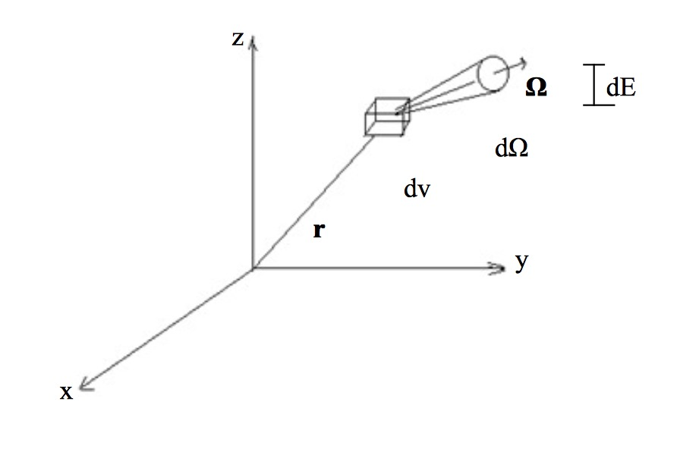
The Radiation Transport Equation (RTE)
Describes transport of uncharged particles (neutrons, photons) in a host medium
Phase space 7-dimensional! Space (3), energy (1),
direction of motion (3), time (1)
Solve for angular flux ψ (speed * neutron density),
typically # DoFs high
Linear integro-differential equation, first order, hyperbolic
Nonlinearity comes from coupling: cross sections depend on temperatures, density changes etc.

Slide 3
Alternative Forms of the RTE
Diffusion approximation:
Approximation of transport equation => linearly anisotropic
Diffusion type equation for each energy group
SAAF equations:
2nd order form of the transport equation
Elliptical set of equation (as opposed to hyperbolic)
Operator Notation:
Streaming & Collision
Lower triangular
Scattering
Fission

Slide 4
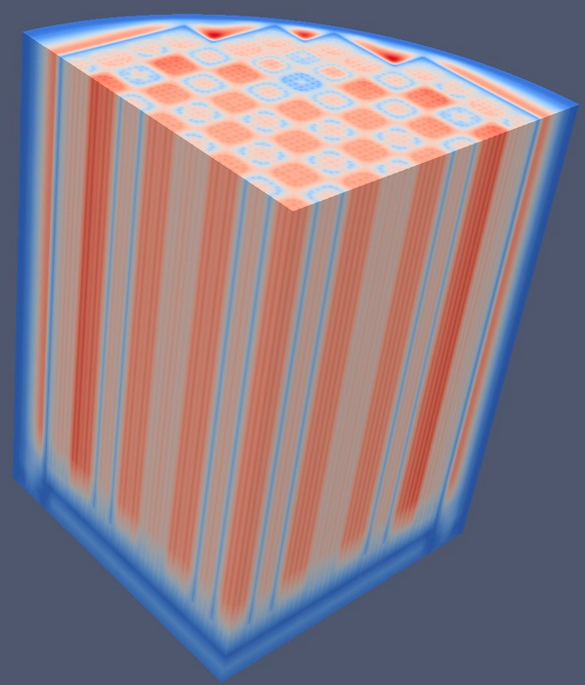
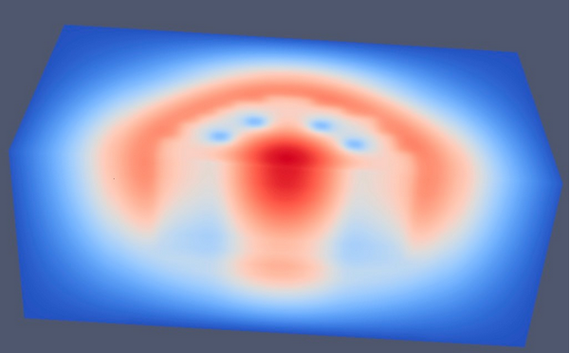
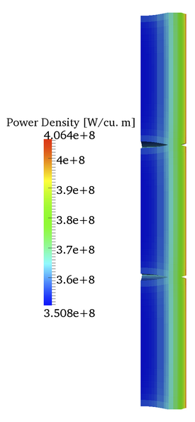
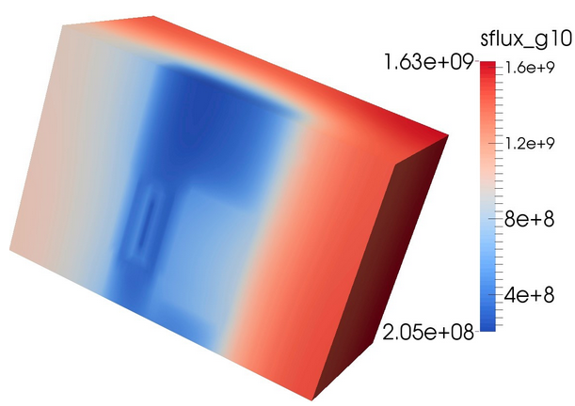
Rattlesnake Applications
PWR: BEAVRs benchmark
RMS: 4% (OPENMC: 5.4%)
TREAT transient analysis &
experiment modeling
Drive Fuel
Performance

Slide 5
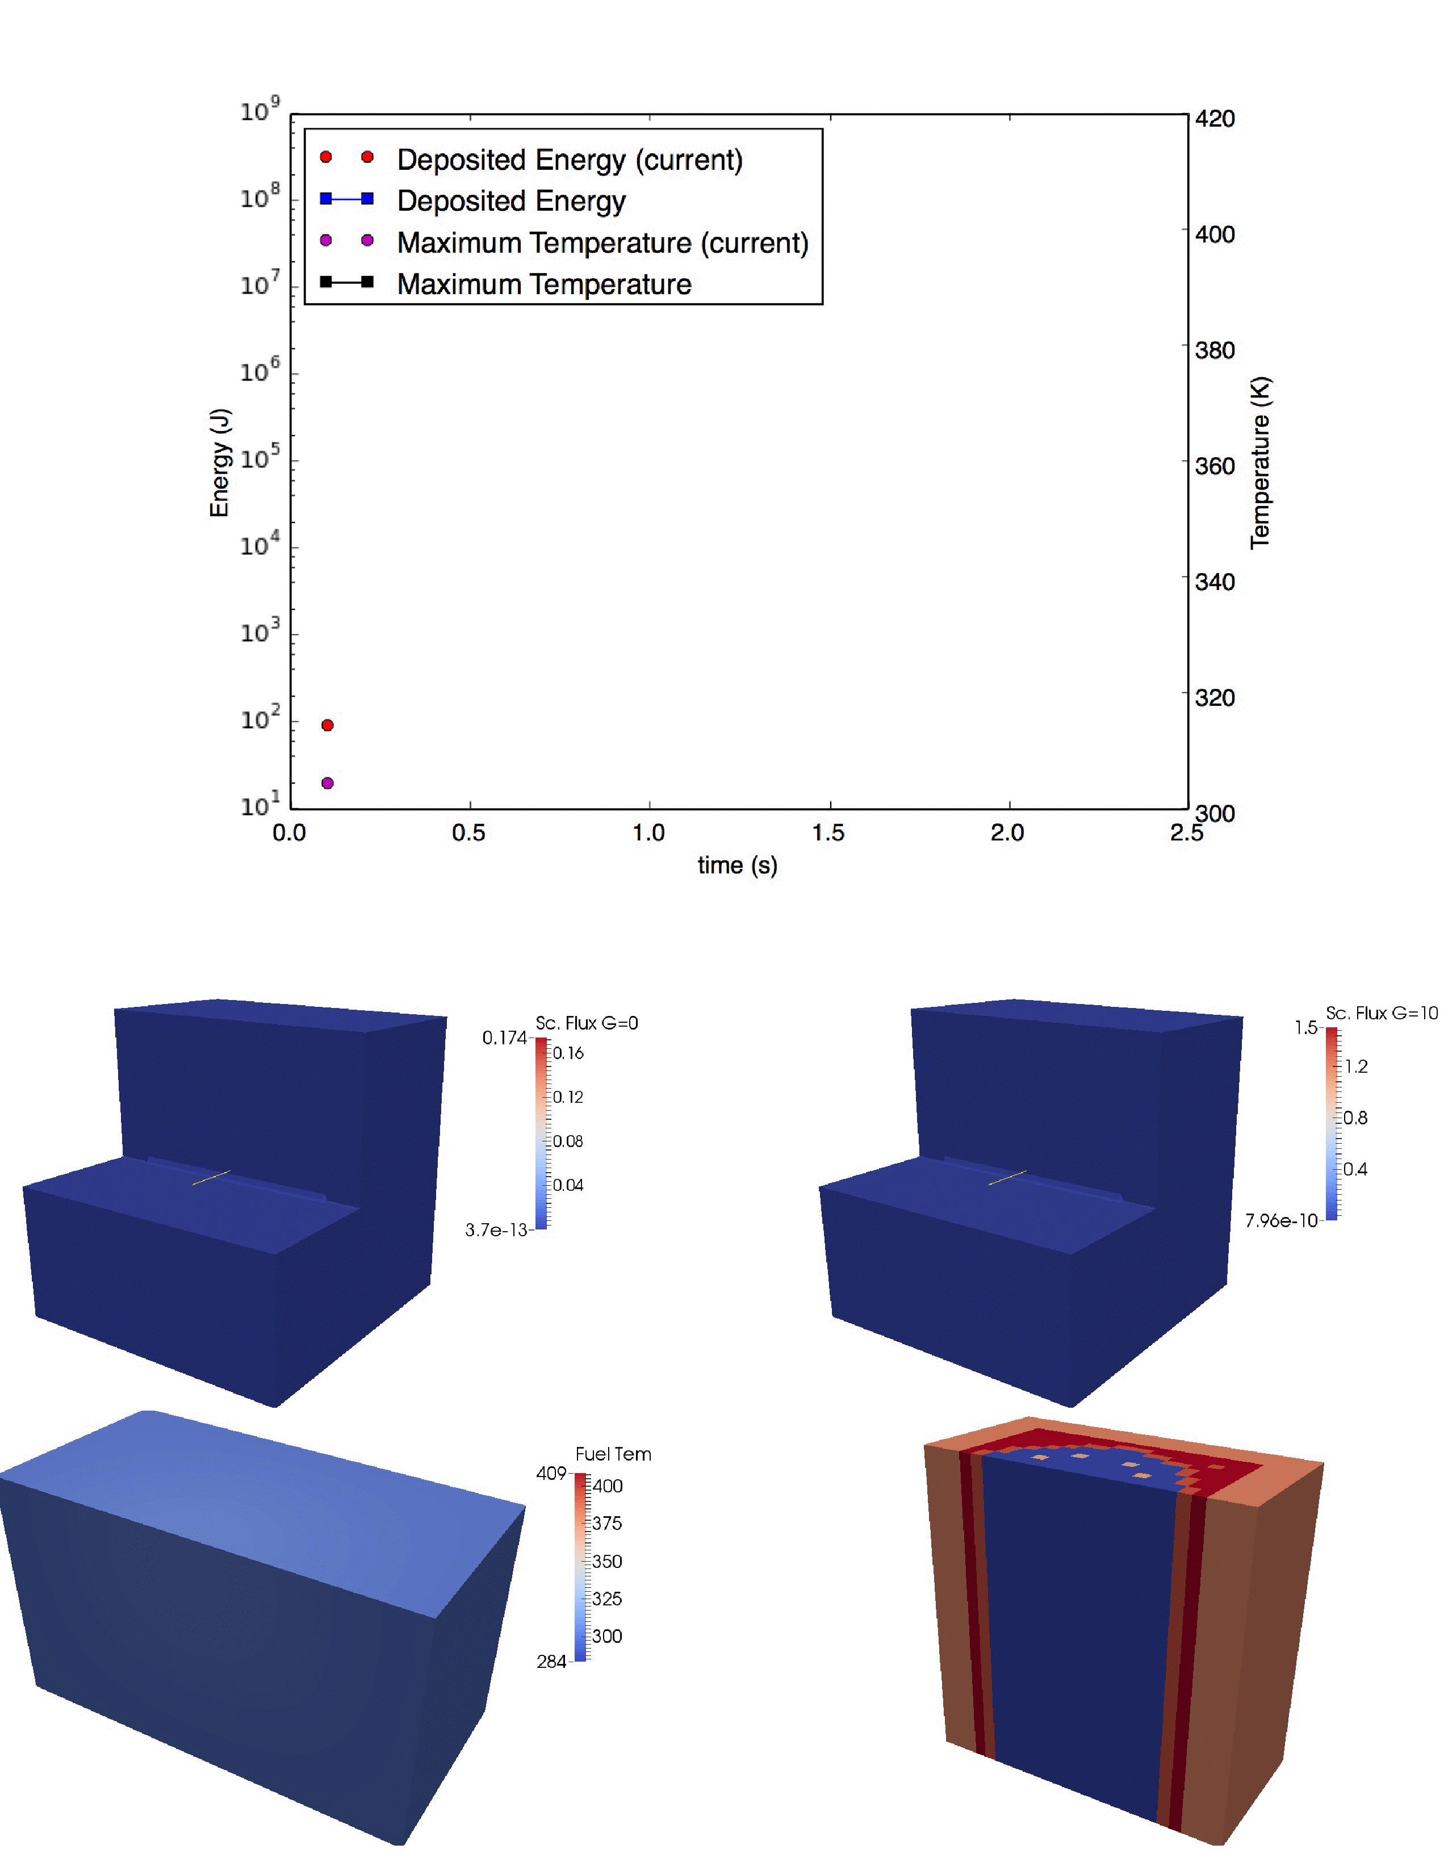
Transient-15
TREAT: transient reactor for
fuel testing
Graphite with tiny fuel particles
Experiment contains tested fuel
Insert reactivity => power increase
(10-20 GW)
Thermal shift kill reactor power

Slide 6
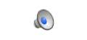
Why is Rattlesnake different?
Oscillating Godiva
Experiment
RSN
MOOSE
LibMesh
Rattlesnake | Standard transport code
Built on LibMesh | Custom spatial discretization
Natural coupling with MOOSE apps | Customized via (fragile) interface
Full Newton, Picard, loose coupling | Loose coupling or Picard
Material properties evaluated at Qps | Constant element properties
2nd order mixed mesh fully supported | 1st order mesh, one or few element types
Inherits timestepping, AMR etc. | Usually focused on transport only
Framework performance penalty | Streamlined

Slide 7
Flexible Nonlinear Diffusion Acceleration (NDA)
Transport Update
L⁻¹ computed via
transport sweep (1st order)
BoomerAMG V-cycles (SAAF)
Flexible 1st order NDA method
Transport: DGFEM discretization
Diffusion: interior penalty DGFEM (advantage: linear/quadratic expansion)
Allows transport & diffusion shape functions & mesh to be different
Evaluate extra terms
Diffusion + Extra Terms
Transport
Update
Update source
Picard iteration scheme

Slide 8
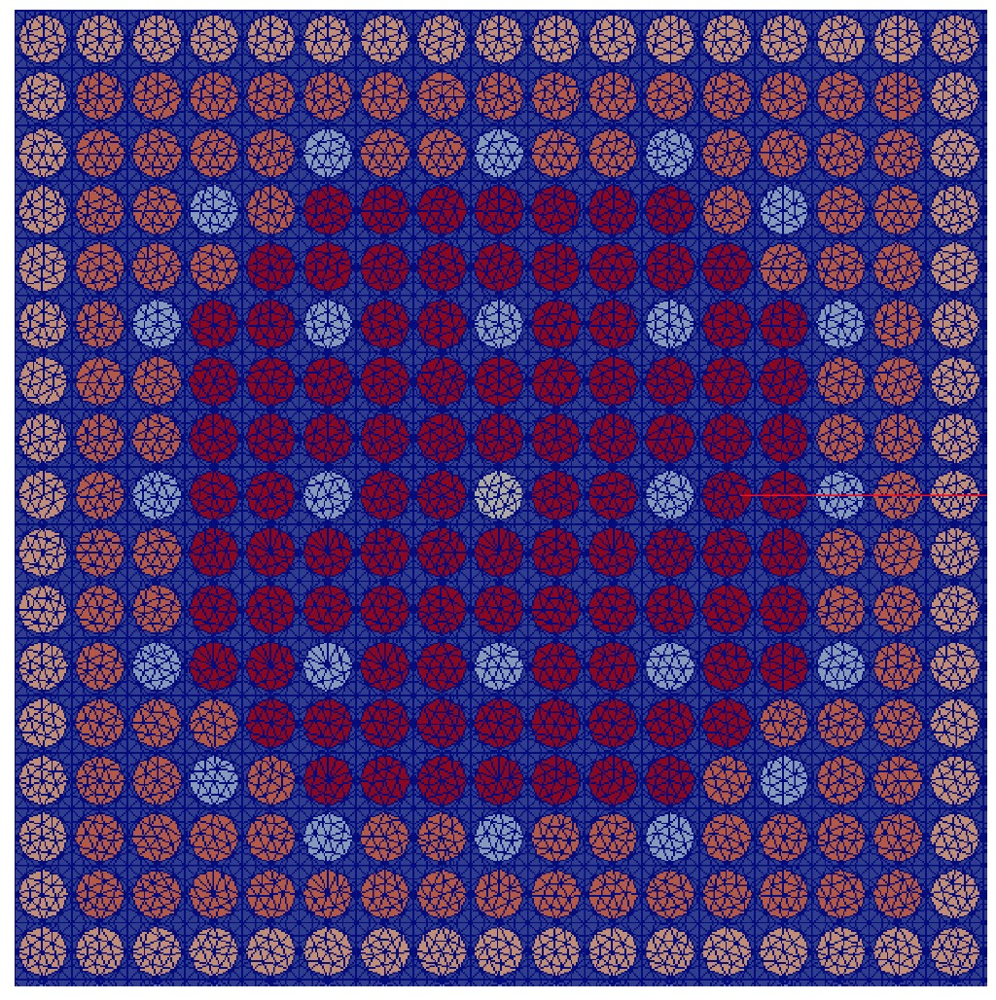
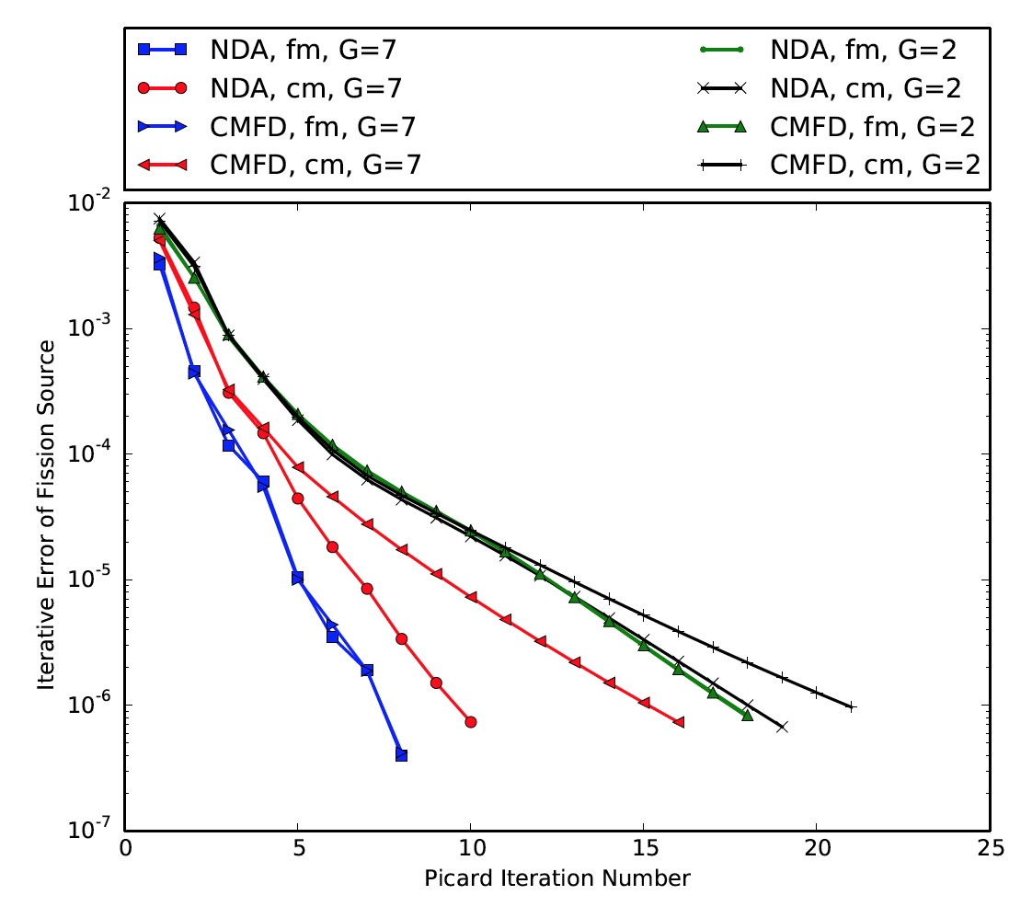
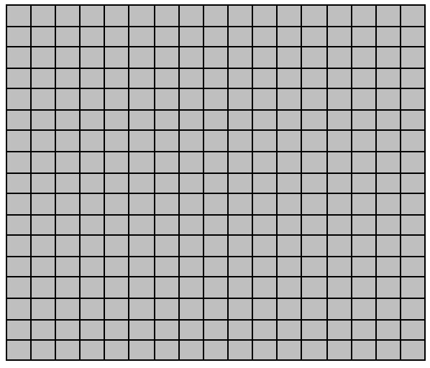
Flexible NDA – 2 (Example)
Flexibility from FEM Projection & Prolongation
C5G7 with pin-cell homogenized diffusion
Results: Flexible NDA better than standard for
pin-cell homogenized diffusion
 | NDA | CMFD
Fine | 8 | 8
Coarse | 10 | 16

Slide 9
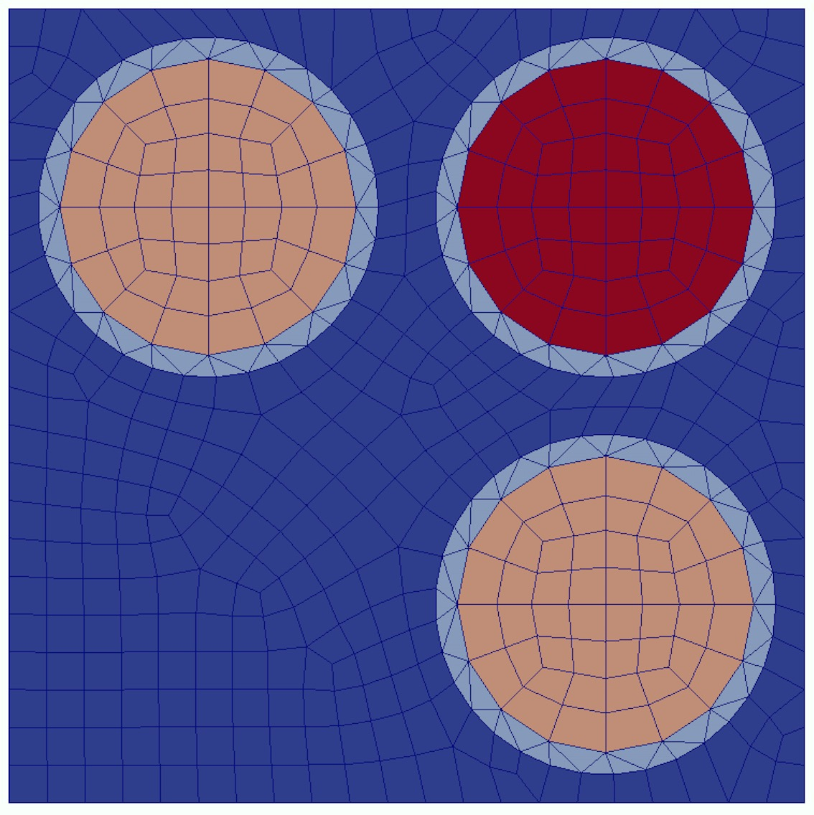
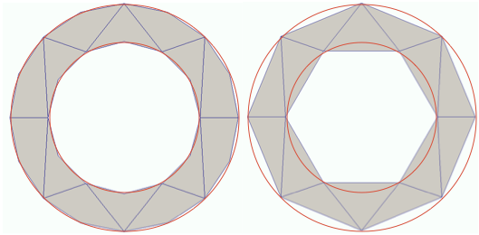
Second Order Sweeps - 1
2nd order
1st order
2nd order mesh: edges are not straight lines but 2nd order curves
Highly beneficial for typical light water reactor geometries (pin/cladding)
Ideas:
GMRES solution on 2nd mesh; precondition with sweep on 1st mesh
Use NDA [diffusion & transport source], sweep on 1st mesh
Both approaches are novel (to our knowledge)

Slide 10
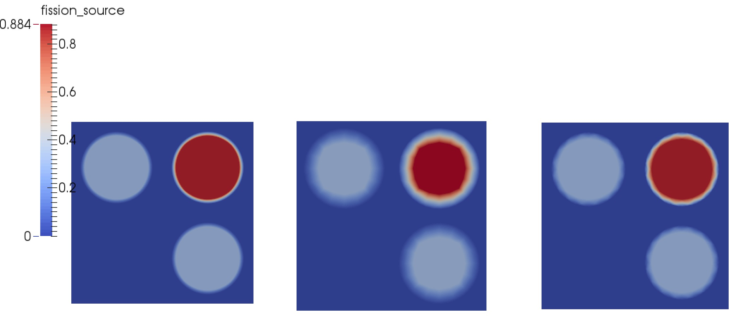
Second Order Sweeps - 2
Results using 1st order mesh, 2nd order mesh, 2nd mesh / sweep 1st mesh
Multiplication factor
keff | Direct (sweep prec.) | NDA | Reference
1st order | 0.710411 | 0.710411 | 0.733041
2nd order | 0.733685 | 0.733683 | -
2nd order/ 1st sweep | 0.733685 | 0.733683 | -
Fission Source Distribution
1st order reference
1st order
2nd order

Slide 11
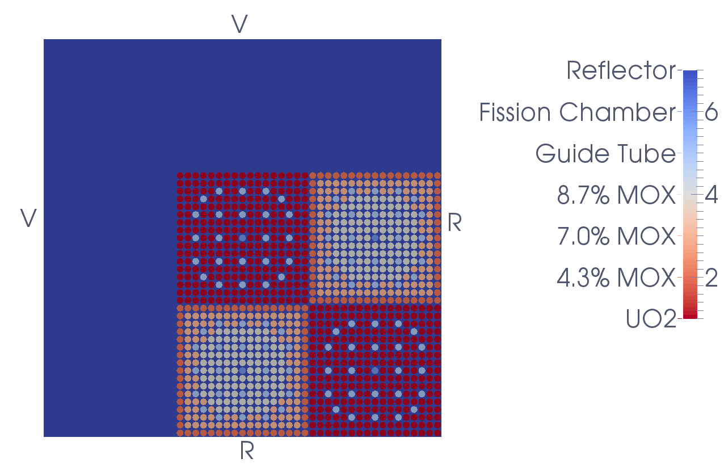
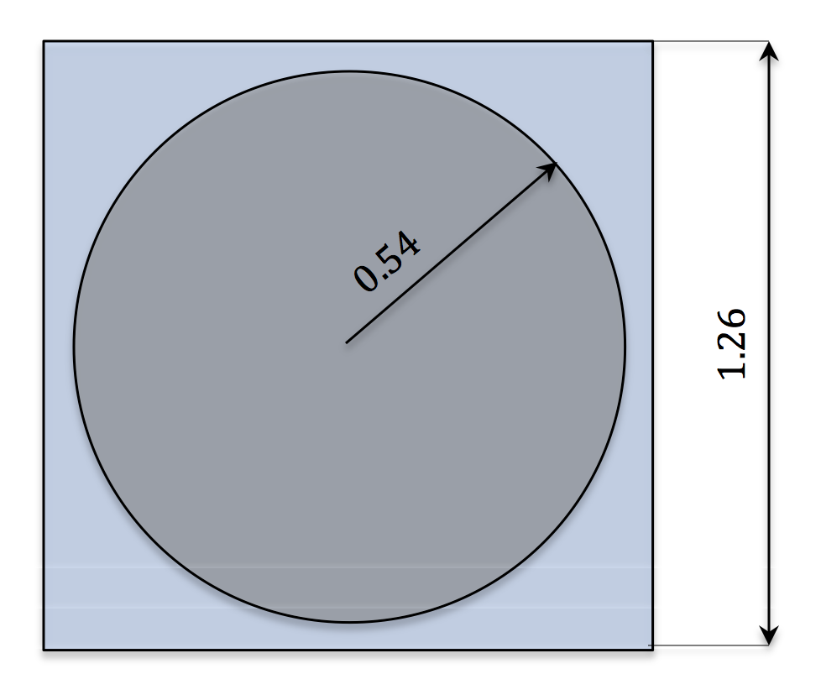
C5G7 Solutions with SAAF-S_{N}
C5G7 is a 2D neutronics benchmark, 2x2 assemblies minicore
Rattlesnake SAAF-SN solution with up to 4.5 x 10¹⁰ DoFs (45 billion)
Largest all-in-one PETSc system?

Slide 12
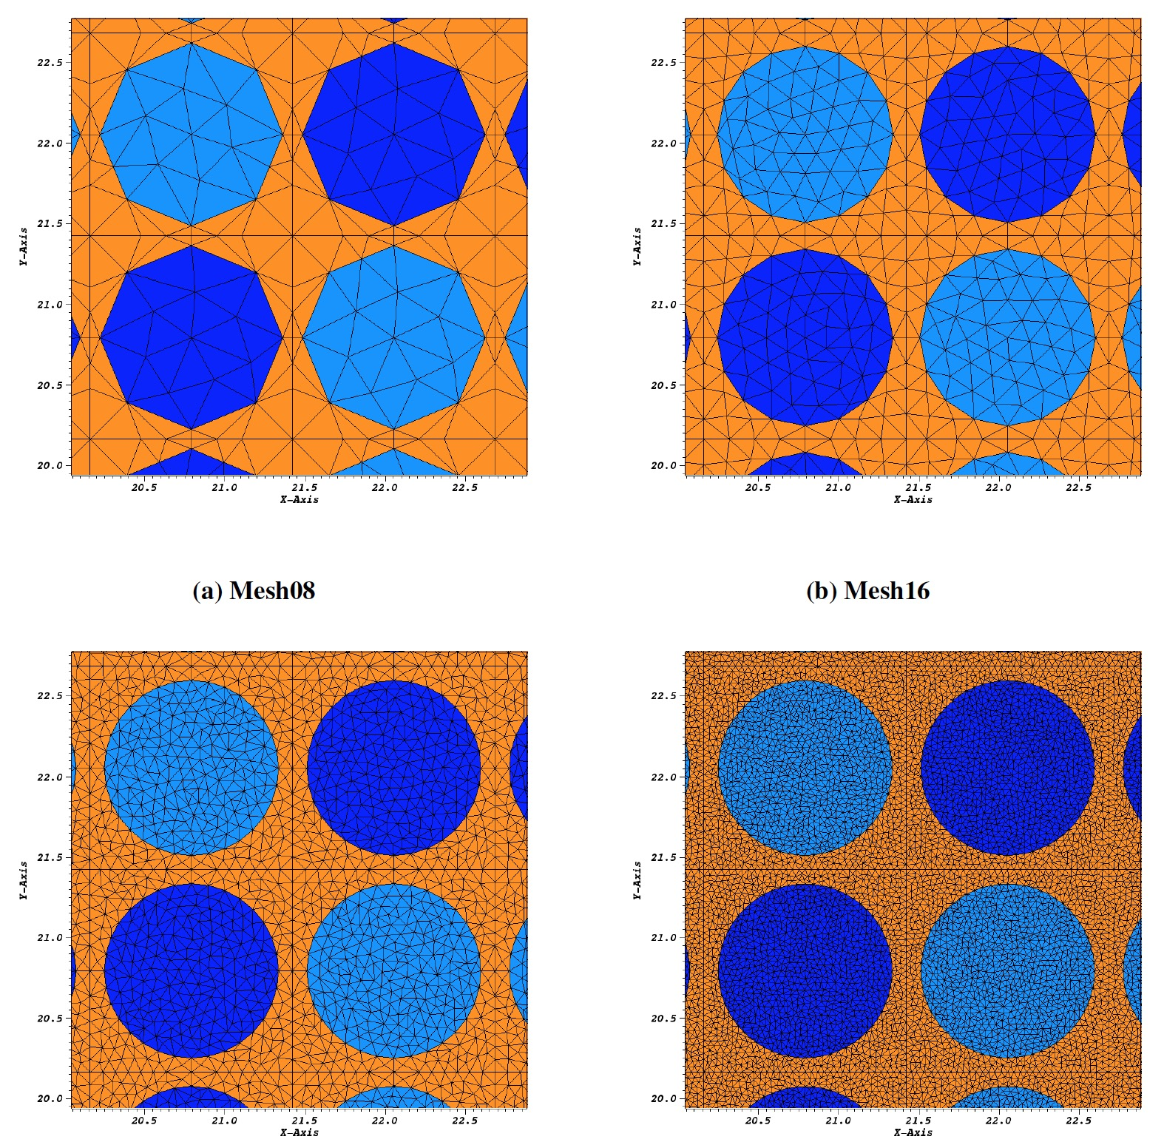
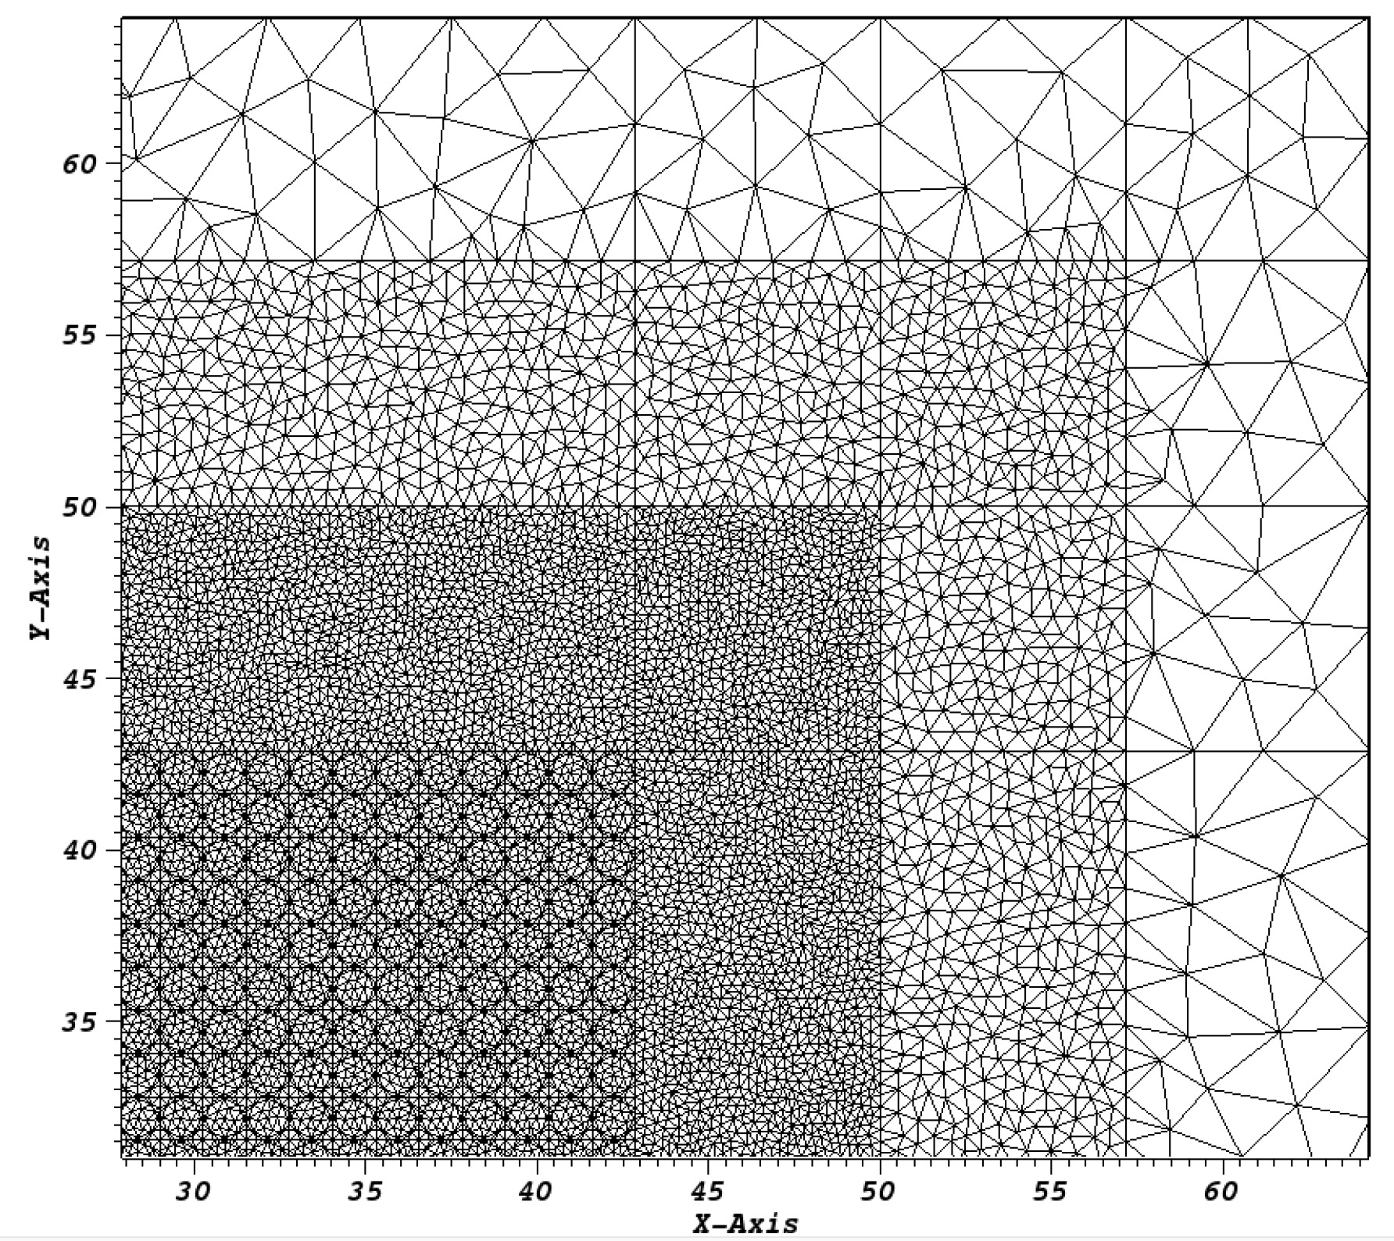
C5G7 Solutions with SAAF-S_{N} - Discretization
Mesh | #elem
8 | 87,108
16 | 265,577
32 | 1,033,668
64 | 4,216,587
Angular Discretization (# direction): NA=8-64, Np=2-5, (1280 directions)
SAAF a coupled system of elliptical equations
K-eigenvalue calculations (forced steady-state) solved via NDA (L⁻¹ via multiple V-cycles & BoomerAMG)

Slide 13
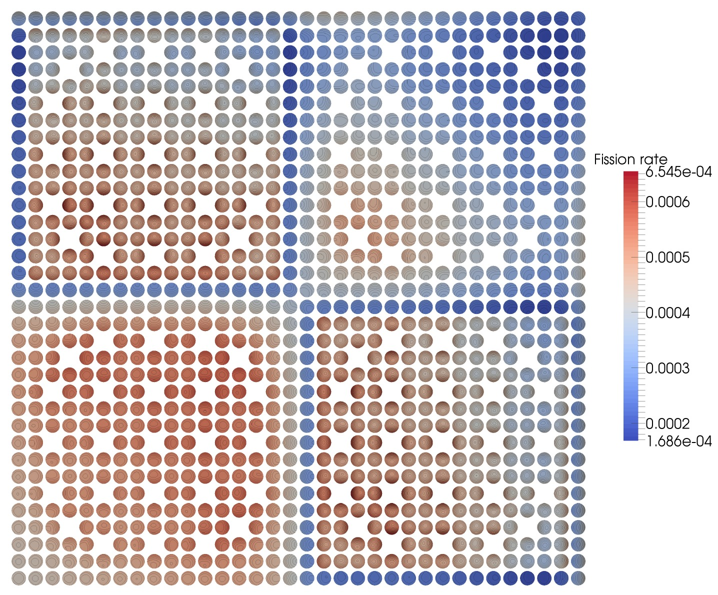
C5G7 Solutions with SAAF-S_{N} - Results
Notable Results
Error k_{eff} (%) | <10⁻³ %
Avg. Pin Power (%) | 0.004
RMS Pin Power (%) | < 0.001
Mean Rel. Pin power (%) | 0.005
# Picard NDA iterations | ~7
Runtime (45 billion DoFs) (2376 CPUs) | 5.6 h
Fission rate, Second order elements,
Mesh 32, N_{A} = 64, N_{p}=4
Reference: MCNP5 Monte Carlo calculation
Nailed the eigenvalue to < 1pcm
Nailed power distribution to < 0.001 %
Efficient execution using < 10h & < 10 (NDA) Picard iterations

Slide 14
Conclusions
Rattlesnake is a LibMesh/MOOSE based radiation transport solver
Designed for multiphysics applications & unique coupling capabilities
Strong focus on transient capabilities
Unique examples in this talk
Effective & flexible NDA method & application to C5G7
Second order sweep capabilities (novel approach)
Largest (?) PETSc system ever solver in SAAF-S_{N} C5G7 solution
Unique challenges: solve highly specialized, huge systems in a general framework!

